Slide 1
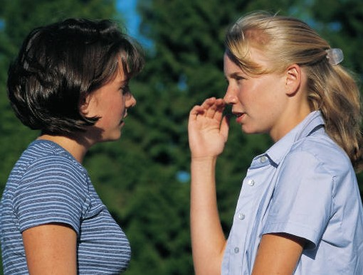
The Gerund
A gerund is the –ing form of a verb. It is used as a noun.

Slide 2
The gerund can be used:
As the subject of a sentence
1- Collecting flowers is my hobby.
2- Riding horses is fun.
3- Coming to class on time is important.
4- Getting daily exercise is important.
5- Learning a second language takes a long time.

Slide 3
As the object of a sentence
Verb + gerund
Enjoy Finish Stop Mind Postpone
Discuss Talk about Think about Like
Give up Avoid Consider Quit

Slide 4
1- I enjoy walking in the park.
2- Ali finished studying at midnight.
3- It stopped raining a few minutes ago.
4- Sam quit smoking.
5- Would you mind opening the window?
6- I am thinking about going to Aden.
7- They discussed getting a new car.
8- I like collecting flowers.

Slide 5
VERBS + INFINITIVES
COMMON VERBS FOLLOWED BY INFINITIVES:
Want Need Hope Except Plan
Decide Mean Promise Seem Agree
Forget Refuse Appear Pretend Try
Offer

Slide 6
GO + -ING
GO is followed by a gerund in certain idiomatic expressions about activities:
1- Did you go shopping yesterday?
2- I went swimming last week.
3- Sam hasn’t gone fishing in years.
4- Adam went camping.
5-Joe likes to go hiking.

Slide 7
PREPOSITION + GERUND
A preposition is followed by a gerund, not an infinitive.
1- Sam insisted on coming with us.
2- We’re excited about going to Alex.
3- I apologized for being late.
4- They are crazy about discovering ancient cities.
5- They are tired of digging in the sand.

Slide 8
COMMON EXPRESSIONS WITH PREPOSITIONS FOLLOWED BY GERUNDS
Be afraid of(doing something)
forgive (someone) for plan on
Believe in be good at be responsible for
Insist on be interested in stop (someone) from
Dream about look forward to be tired of
Thank (someone) for worry about be excited about
Be bad at be nervous about

Slide 9
The Gerund as adjective
1- There is an increasing amount of pollution.
2- This is a very exciting idea.
3- She received them with a warm welcoming smile.

